Slide 1
Computer vision: models, learning and inference
Chapter 5
The Normal Distribution

Slide 2
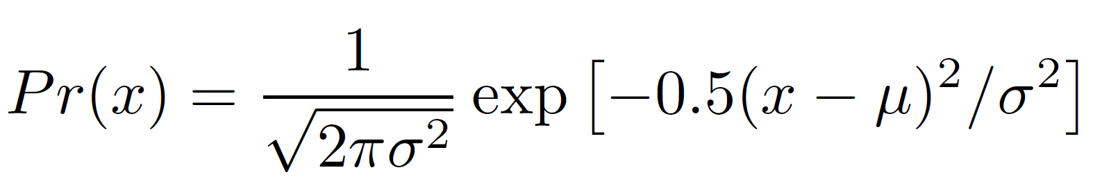
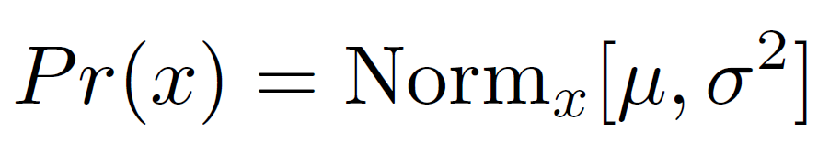
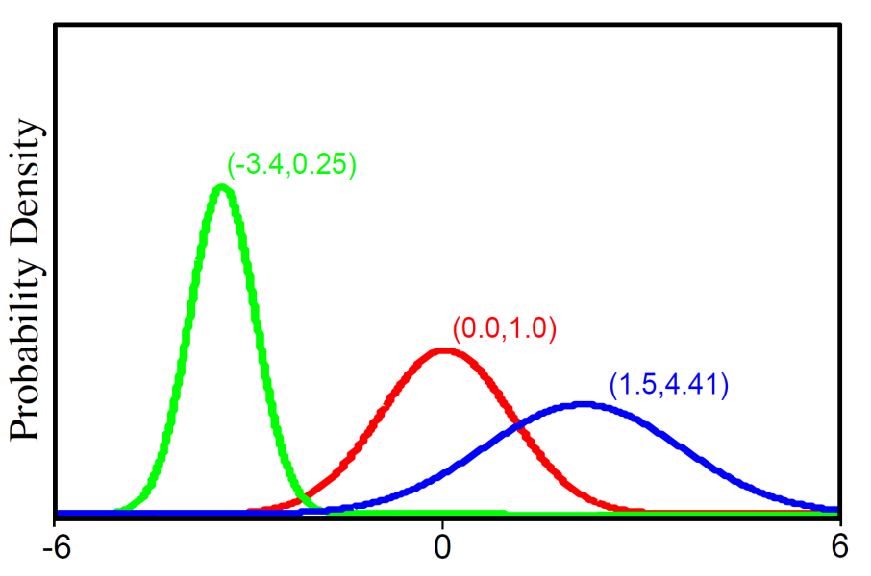
Univariate Normal Distribution
For short we write:
Univariate normal distribution describes single continuous variable.
Takes 2 parameters μ and σ²>0

Slide 3
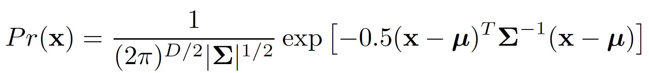
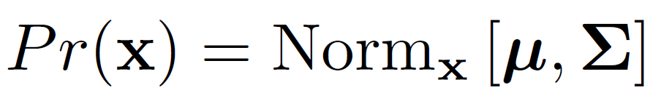





Multivariate Normal Distribution
For short we write:
Multivariate normal distribution describes multiple continuous variables. Takes 2 parameters
a vector containing mean position, μ
a symmetric “positive definite” covariance matrix Σ
Positive definite: is positive for any real

Slide 4
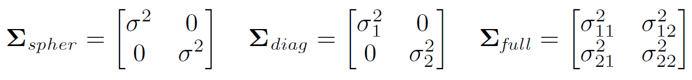

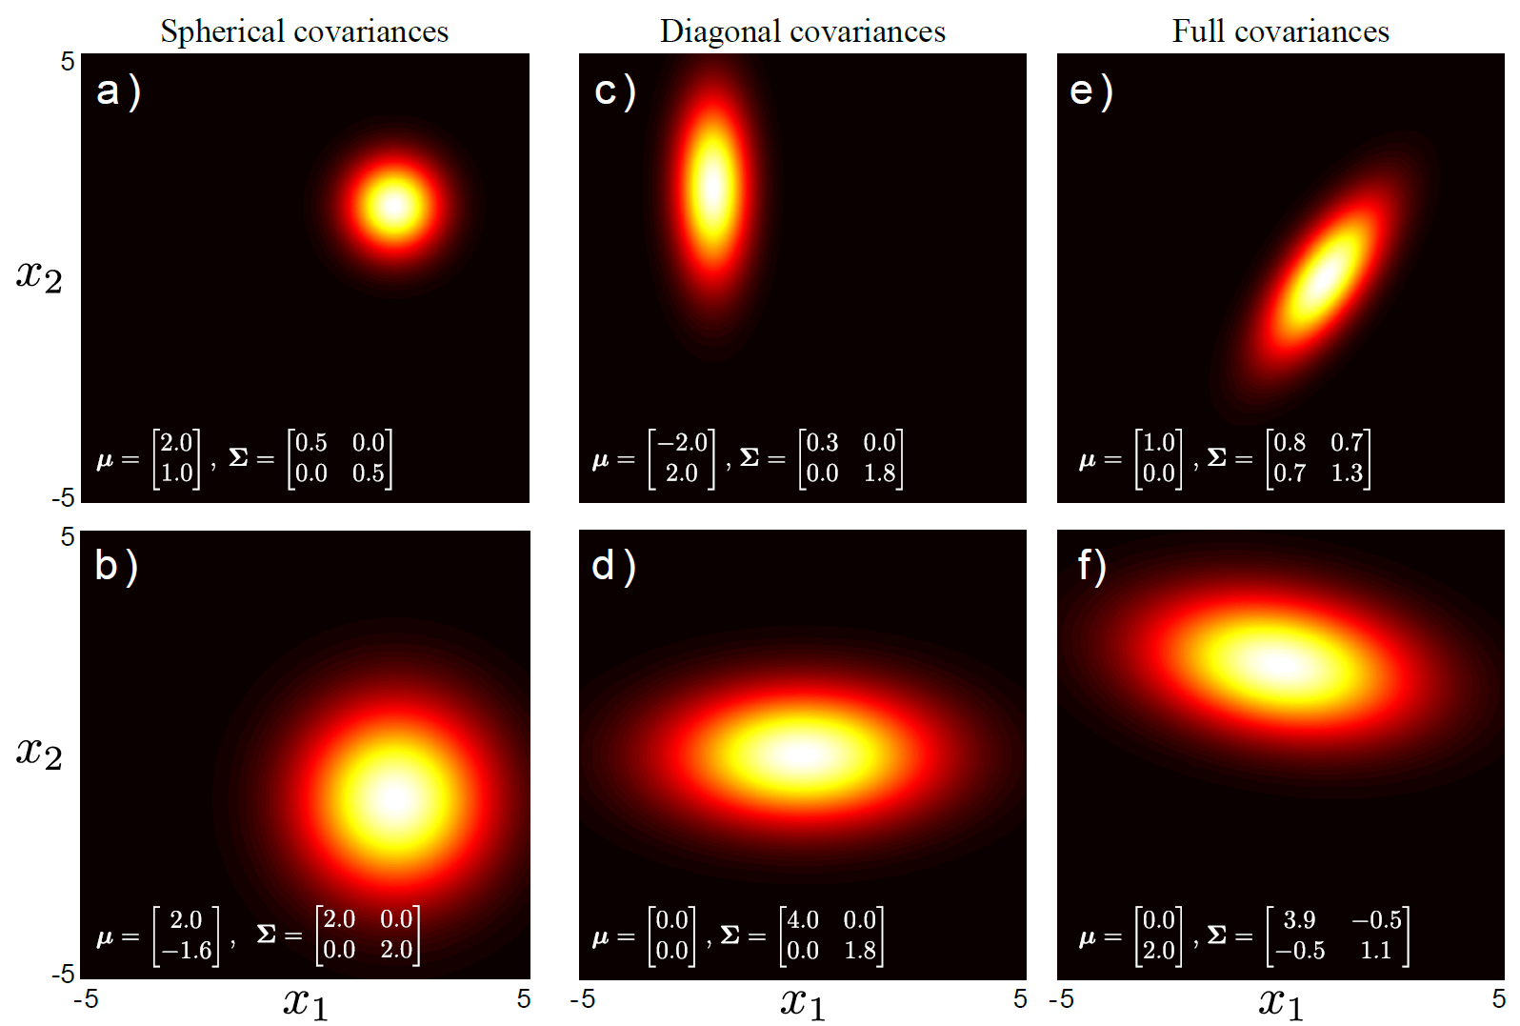

















Types of covariance
Symmetric

Slide 5
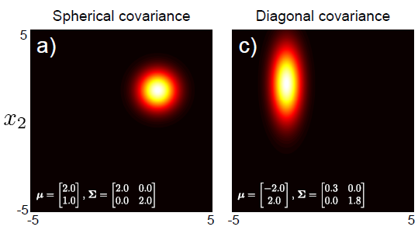
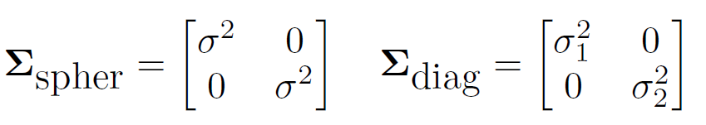
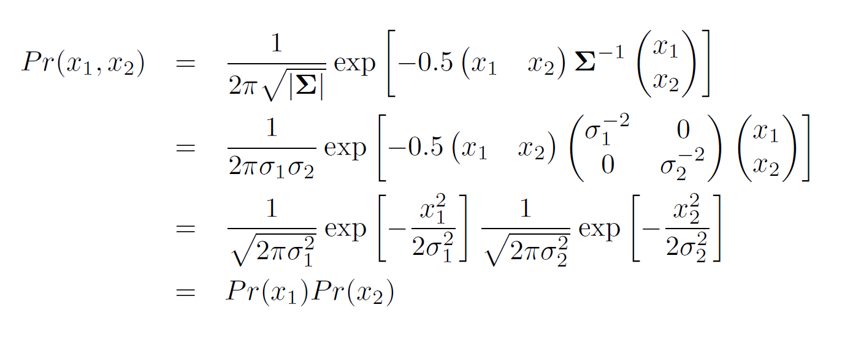
Diagonal Covariance = Independence

Slide 6
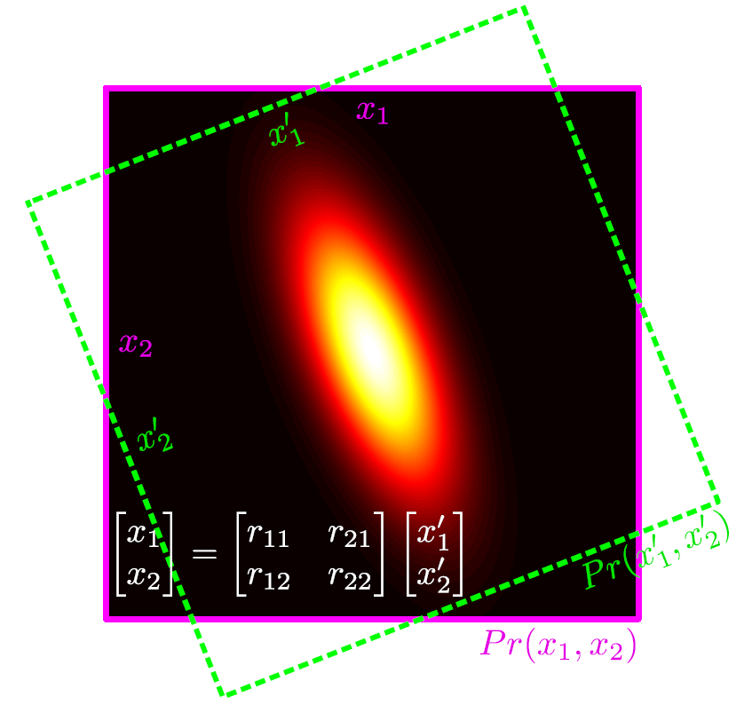
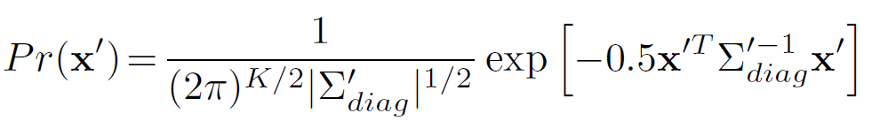

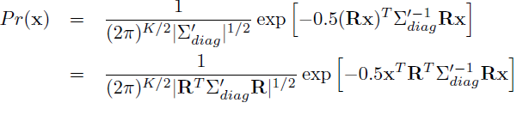
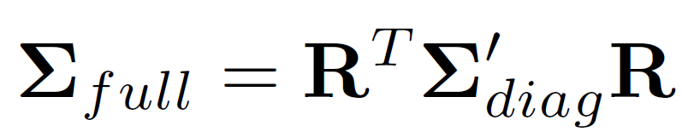

Decomposition of Covariance
Consider green frame of reference:
Relationship between pink and green frames of reference:
Substituting in:
Full covariance can be decomposed into rotation matrix and diagonal
Conclusion:

Slide 7
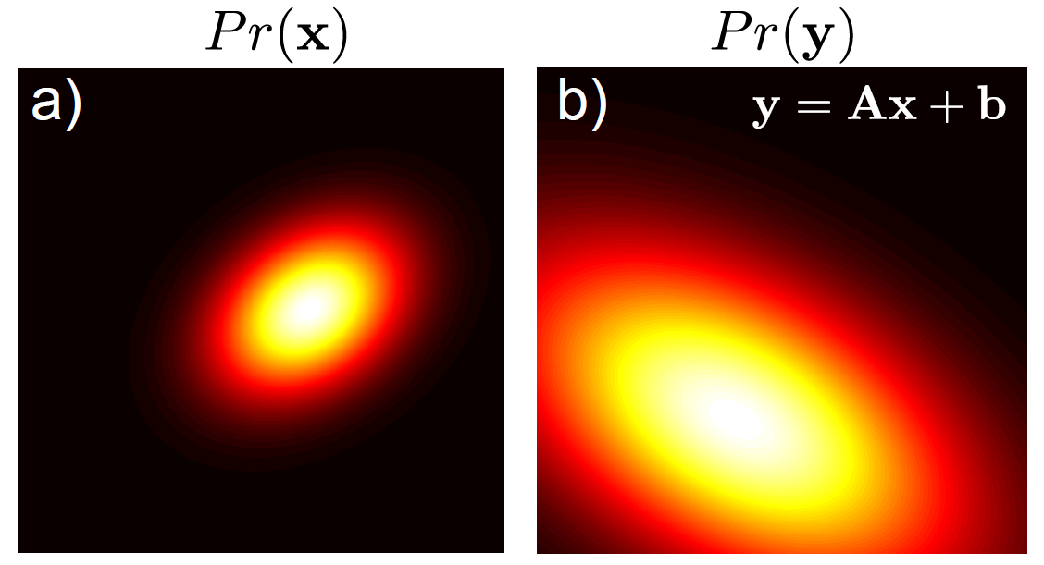

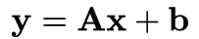
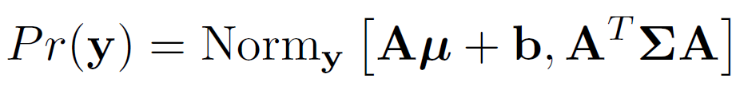
Transformation of Variables
If
and we transform the variable as
The result is also a normal distribution:
Can be used to generate data from arbitrary Gaussians from standard one

Slide 8
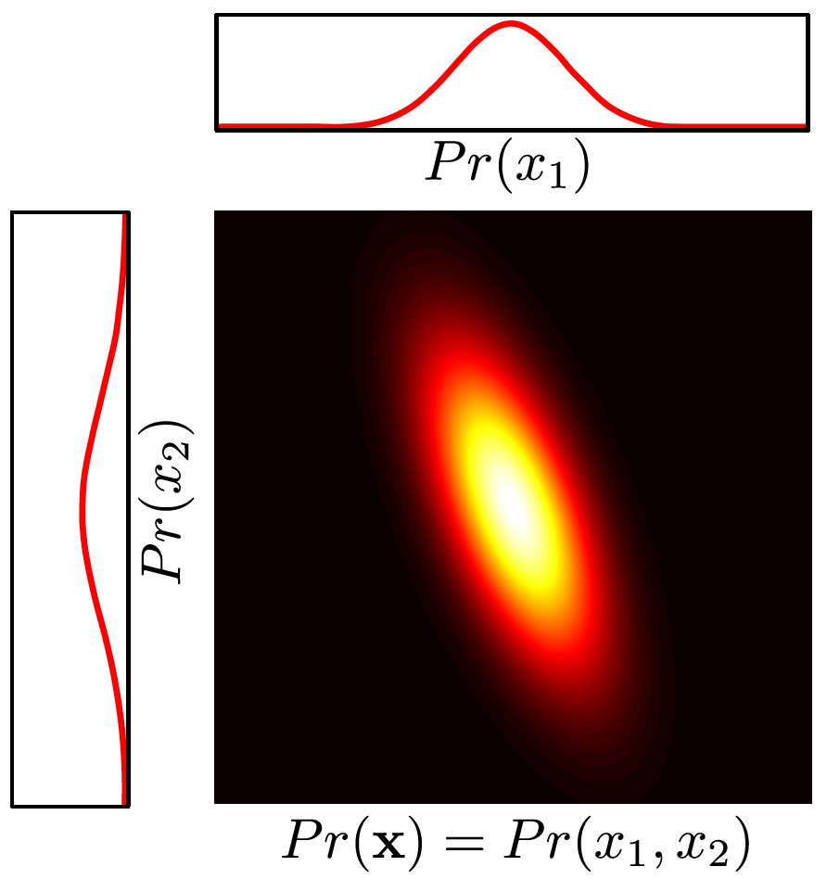
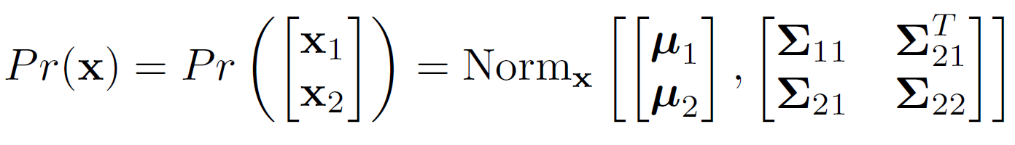
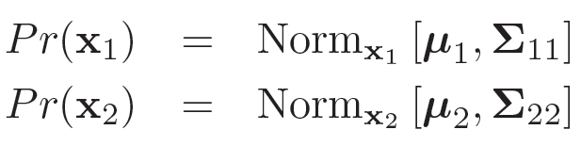
Marginal Distributions
Marginal distributions of a multivariate normal are also normal
If
then

Slide 9
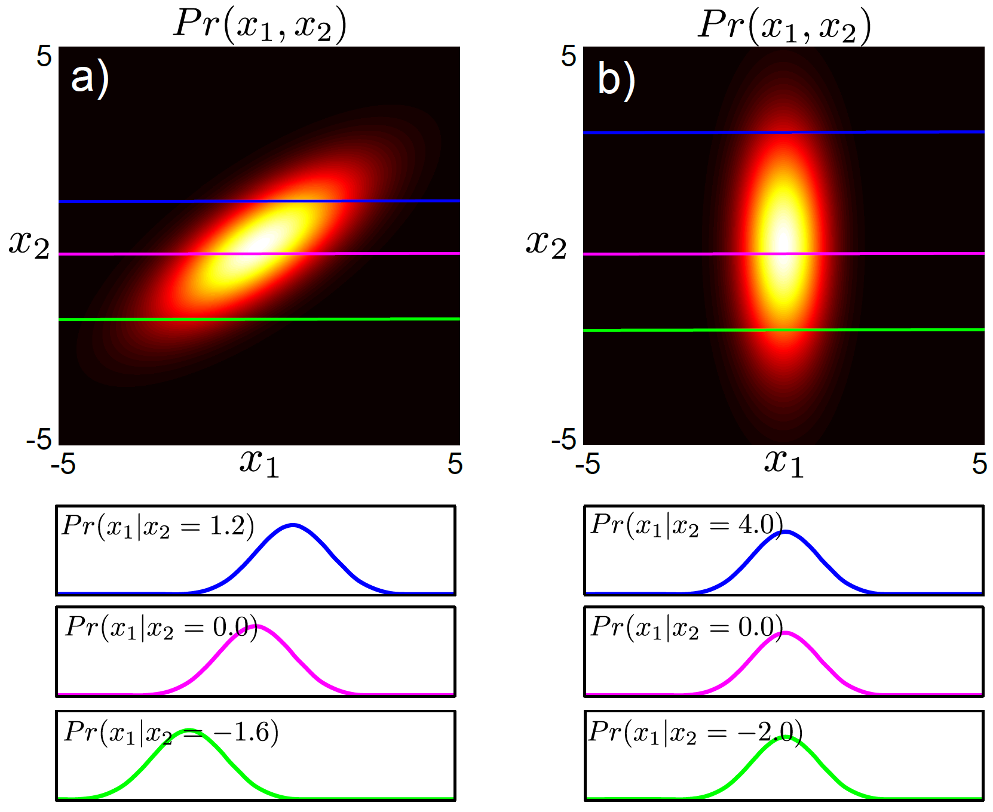
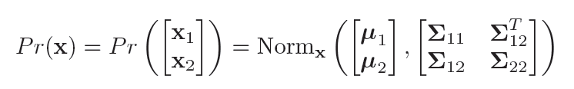
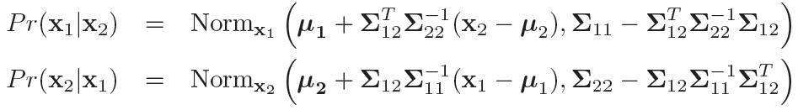
Conditional Distributions
If
then

Slide 10
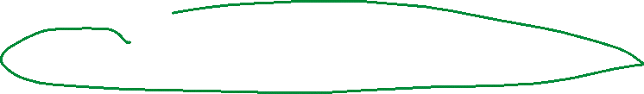
Conditional Distributions
For spherical / diagonal case, x₁ and x₂ are independent so all of the conditional distributions are the same.

Slide 11
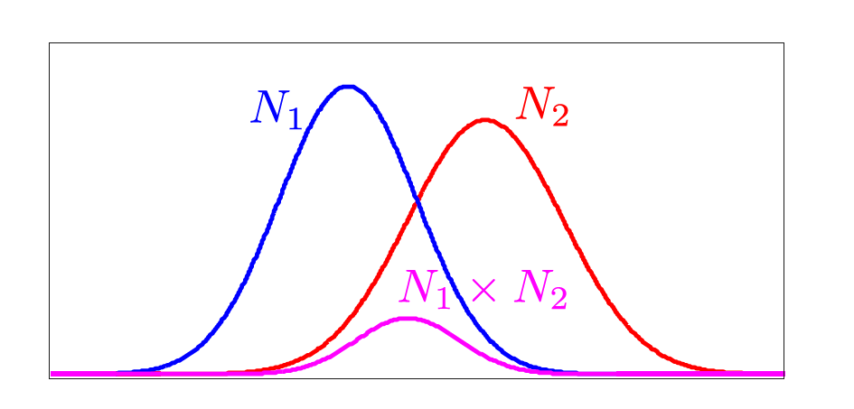
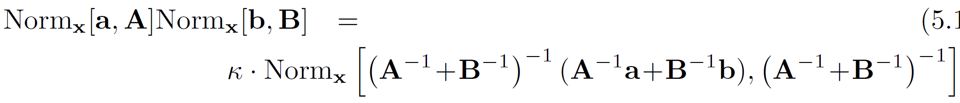
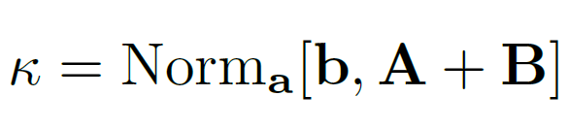
Product of two normals (self-conjugacy w.r.t mean)
The product of any two normal distributions in the same variable is proportional to a third normal distribution
Amazingly, the constant also has the form of a normal!

Slide 12
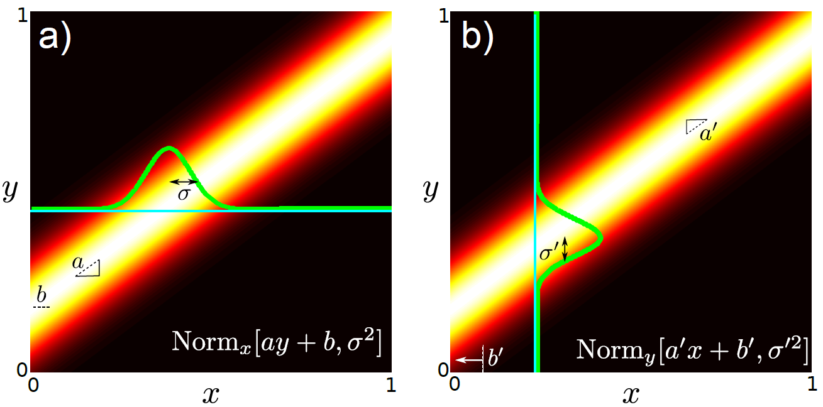
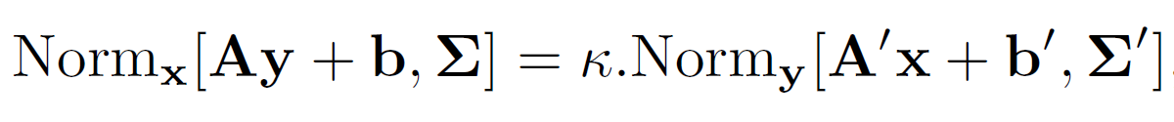
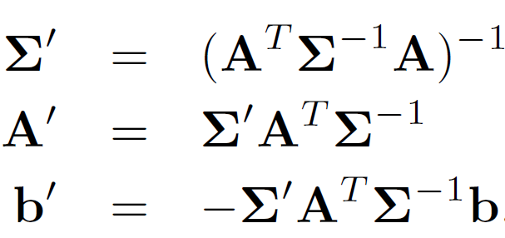





Change of Variables
If the mean of a normal in x is proportional to y then this can be re-expressed as a normal in y that is proportional to x
where

Slide 13


Conclusion
Normal distribution is used ubiquitously in computer vision
Important properties:
Marginal dist. of normal is normal
Conditional dist. of normal is normal
Product of normals prop. to normal
Normal under linear change of variables

